Slide 1





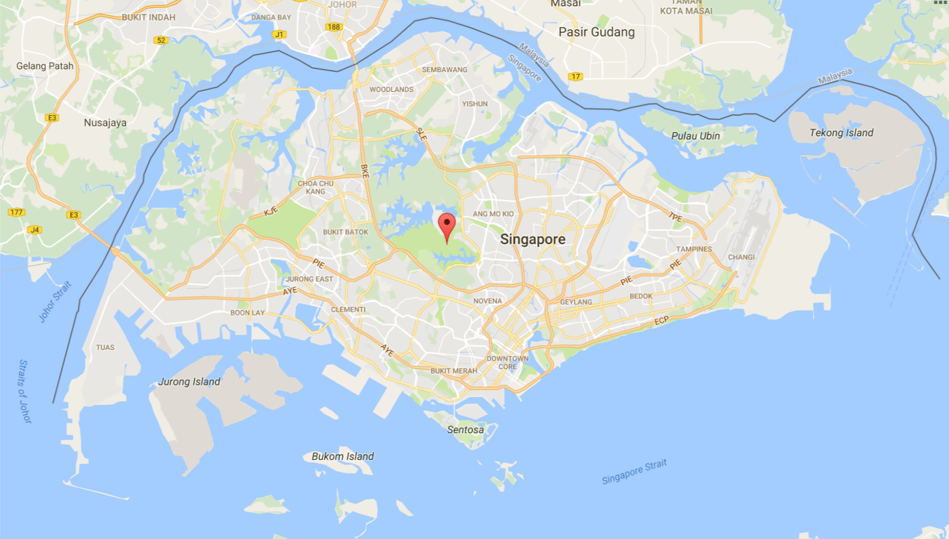













Login
REPORT ACCIDENT
Accident Report
Report Accident
Enforcement Camera
Statistics
Filter
Accident
Speed Camera
Traffic Camera
Reset
Notes:
First Page
Click menu bar – Slide 2

Slide 2
Login
REPORT ACCIDENT
Filter
Accident
Speed Camera
Traffic Camera
Reset
Notes:
Click Report Accident – Slide 3
Click Login – Slide 6

Slide 3


Login
REPORT ACCIDENT
Location
Current Location
Description of Accident
DD/MM/YYYY
03
04
17
Ok
Cancel
Filter
Accident
Speed Camera
Traffic Camera
Reset
Notes:
Click Ok – Slide 5
Click Red Pin to choose location – Slide 4

Slide 4
Login
Login
REPORT ACCIDENT
Reservoir Park
Ok
Filter
Accident
Speed Camera
Traffic Camera
Reset

Slide 5
Login
REPORT ACCIDENT
Your accident report has been submitted
Thank you for your contribution
Ok
Filter
Accident
Speed Camera
Traffic Camera
Reset
Notes:
Click Ok – Slide 2

Slide 6



Login
REPORT ACCIDENT
Username
Password
Login
Forgot your password?
Filter
Accident
Speed Camera
Traffic Camera
Notes:
Click Login – Slide 7

Slide 7



FirstName LastName
FirstName LastName
REPORT ACCIDENT
Accident Report
Report Accident
Pending Reports
4
View Reports
Enforcement Camera
Statistics
Filter
Accident
Speed Camera
Traffic Camera
Pending Camera
Reset
Notes:
Click Pending Reports – Slide 8
Click Enforcement Camera – Slide 13
Click Statistics – Slide 18

Slide 8


FirstName LastName
Pending Reports
Location: Tampines Ave 12
Cause: Unknown
Date 4/2/2017
Location: Tampines Ave 12
Cause: Unknown
Date 4/2/2017
Location: Jurong East Street 9
Cause: Unknown
Date 4/2/2017
Location: Clementi Ave 5
Cause: Unknown
Date 4/2/2017
Notes:
Click Red Pin for location – Slide 9
Click Green Tick to approve report – Slide 10
Click Red Cross to reject report – Slide 12

Slide 9
FirstName LastName
Pending Reports
Tampines Ave 12
Description
4 Feb 2017 HH:mm
Location: Tampines Ave 12
Cause: Unknown
Date 4/2/2017
Location: Jurong East Street 9
Cause: Unknown
Date 4/2/2017
Location: Clementi Ave 5
Cause: Unknown
Date 4/2/2017

Slide 10
FirstName LastName
Pending Reports
Approve Report
Location: Tampines Ave 12
Cause: Unknown
Date 4/2/2017
Location
Location: Tampines Ave 12
Cause: Unknown
Date 4/2/2017
Tampines Street 12
Location: Jurong East Street 9
Cause: Unknown
Date 4/2/2017
Cause of Accident
Unknown
Location: Clementi Ave 5
Cause: Unknown
Date 4/2/2017
DD/MM/YYYY
03
04
17
Ok
Cancel
Notes:
Click Ok – Slide 11

Slide 11
FirstName LastName
Pending Reports
Location: Tampines Ave 12
Cause: Unknown
Date 4/2/2017
The accident report has been approved by
FirstName LastName
The accident can be now viewed on the map for the public
Location: Tampines Ave 12
Cause: Unknown
Date 4/2/2017
Location: Jurong East Street 9
Cause: Unknown
Date 4/2/2017
Location: Clementi Ave 5
Cause: Unknown
Date 4/2/2017
Ok
Notes:
Click Ok – Slide 8

Slide 12
FirstName LastName
Pending Reports
Location: Tampines Ave 12
Cause: Unknown
Date 4/2/2017
Location: Tampines Ave 12
Cause: Unknown
Date 4/2/2017
Confirm Removal of Accident Report?
Location: Jurong East Street 9
Cause: Unknown
Date 4/2/2017
Location: Clementi Ave 5
Cause: Unknown
Date 4/2/2017
Confirm
Cancel
Notes:
Click Ok – Slide 8

Slide 13
FirstName LastName
FirstName LastName
REPORT ACCIDENT
Accident Report
Enforcement Camera
Add Camera
Manage Cameras
Statistics
Filter
Accident
Speed Camera
Traffic Camera
Pending Camera
Reset

Slide 14


FirstName LastName
Enforcement Cameras
ID: 9999
Location: Upper Thomson Road
Latitude: 1.38686495512772
Longitude: 103.820397045181
Type: Speed Camera
Status: Pending
ID: 4100
Location: Upper Thomson Road
Latitude: 1.38686495512772
Longitude: 103.820397045181
Type: Traffic Camera
Status: Installed
ID: 4118
Location: Tampines Ave 7
Latitude: 1.3692078755048
Longitude: 103.970098793517
Type: Traffic Camera
Status: Installed
ID: 4100
Location: Boon Lay Way
Latitude: 1.337136
Longitude: 103.740464
Type: Traffic Camera
Status: Installed
Traffic Camera
Speed Camera
Pending Camera
ID: 9110
Location: Bukit Timah Expressway
Latitude: 1.382224894418
Longitude: 103.775522244554
Type: Speed Camera
Status: Installed
Notes:
Click Plus – Slide 15

Slide 15
FirstName LastName
Enforcement Cameras
Reservoir Park
Next
Notes:
Click Next – Slide 16

Slide 16
FirstName LastName
Enforcement Cameras
Add Enforcement Camera
Location
Upper Thomson Road
1.38686495512772
Latitude
Longitude
103.820397045181
Type
Speed Camera
Status
Pending
Confirm
Cancel
Notes:
Click Confirm – Slide 17

Slide 17
FirstName LastName
Enforcement Cameras
Enforcement Camera Added
Location :
Upper Thomson Road
1.38686495512772
Latitude :
Longitude :
103.820397045181
Type :
Speed Camera
Status :
Pending
Ok
Notes:
Click Ok – Slide 14

Slide 18

FirstName LastName
FirstName LastName
REPORT ACCIDENT
Accident Report
Enforcement Camera
Statistics
View Statistics
Filter
Accident
Speed Camera
Traffic Camera
Pending Camera
Reset
Notes:
Click View Statistics by Location – Slide 19

Slide 19
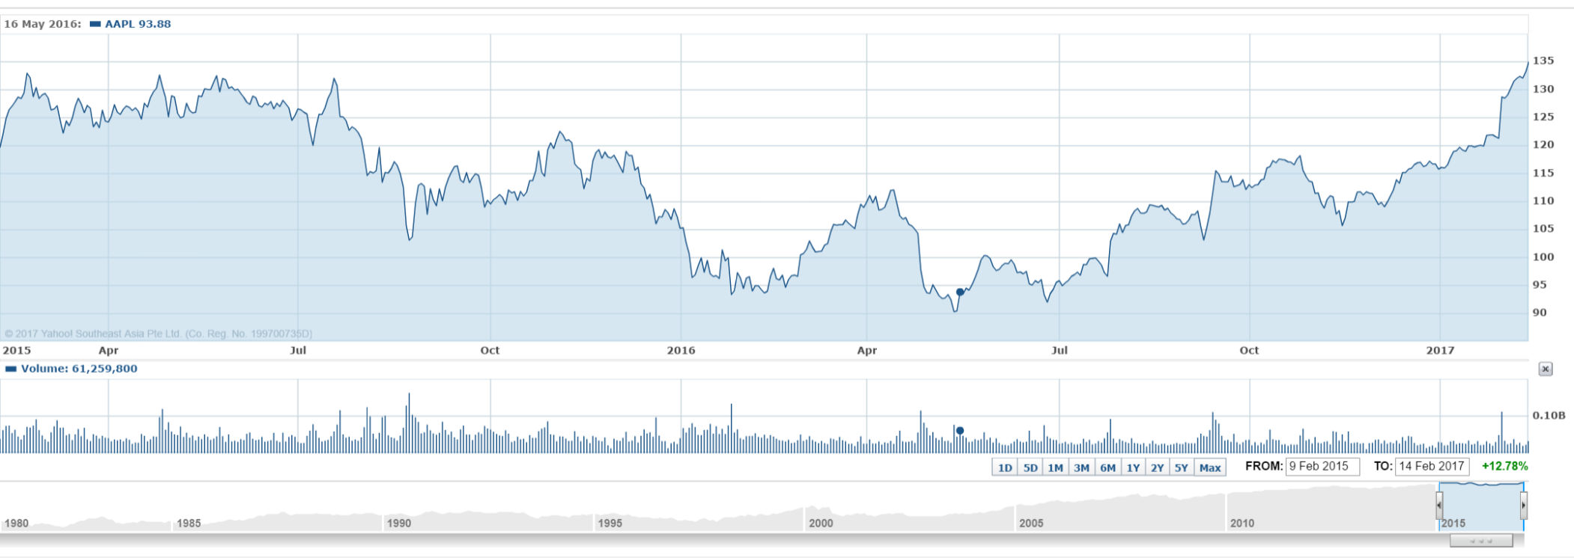

FirstName LastName
Statistics
10
30
From
5
01/01/2017
5
9
To
70
15
01/03/2017
120
Reset

